Slide 1



US healthcare
INSURANCE

Slide 2






Prescription Coverage
US healthcare
Health insurance plans help patients access essential medications by covering part of the cost of prescribed drugs
introduction
In the United States, healthcare is not financed mainly by the government, but through private health insurance plans.
Instead of having one national system, many independent insurance companies offer different plans, each with its own costs, rules, and levels of coverage. Because of this, choosing a health plan can be complex, and understanding the structure of the system is essential.
Medical Services
Plans provide coverage for doctor visits, check-ups, and essential medical care through approved networks of providers.
Affordable Treatments
Insurance reduces out-of-pocket expenses for treatments, allowing patients to receive care without high financial burden.

Slide 3














Problematics
Solutions
Summary
Workflow
Recommandations

Slide 4












01
02
03
How do plan prices vary across states and coverage levels?
Which states offer the most affordable health plans?
How to predict prices based on individuals differences?
Problematics
Within each state, prices also shift across coverage levels: higher levels (like Gold or Platinum) generally show higher premiums, while lower levels (like Bronze) usually stay at the lower end of the price range.
States with lower medical costs and more insurer competition tend to offer the most affordable plans.
These are often in the Midwest and some Northeastern regions.
Prices can be predicted by linking individual factors (age, state, metal level, etc.) to premiums.
A machine learning model uses these patterns to estimate the price for each person

Slide 5





Solutions
the solutions we’re undergoing to respond to the problematics
01
02
analyzing prices per metal level, and other characteristics
analyzing the most important features of rates to predict the costs of a specific plan
checking how premiums change from Bronze to Platinum, since each level has different coverage and cost, comparing these prices with other characteristics—like state, age, and plan type—to see how each factor influences the final premium and identify patterns or differences across groups.
To predict a plan’s cost, you analyze the most important features that influence rates, such as age, state, metal level, and plan type.
By focusing on these key factors, a model can accurately estimate the expected premium for a specific plan.
03
repartition of plans and premiums per state
shows how many plans are offered in each state and the range of their prices. Some states have more plan options and higher premiums, while others offer fewer plans at lower costs, reflecting differences in healthcare markets and competition.

Slide 6












WorkFlow
The overall workflow prepares the data step-by-step, so the final dataset is accurate, organized, and ready for meaningful insights.
Dashboarding and Visualization
Machine
Learning
Extracting Data
Cleaning & Joins

Slide 7
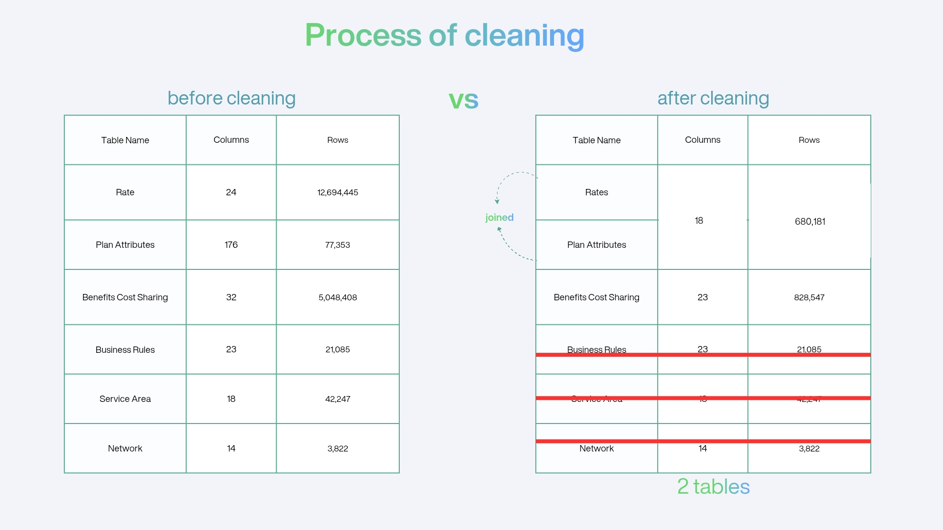
Notes:
our analysis needs did not require using the 3 tables, since the data is big

Slide 8


Dashboard
let’s all look at the dashboard in power bi

Slide 9
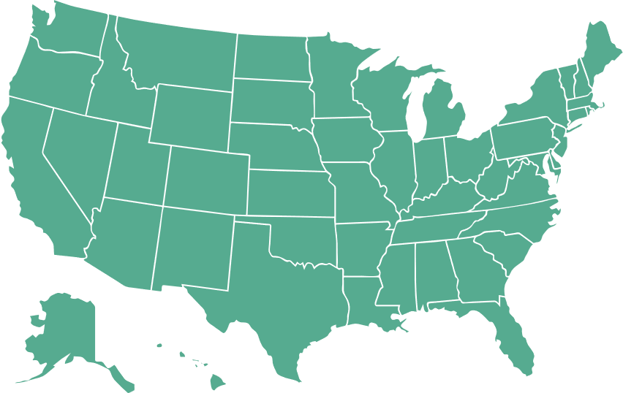



Recommandations
plans repartition
high priced plans
Insurance providers operate regionally and must comply with state-specific regulations. As a result, some states have many plan options, while others have limited choices. This creates unequal access to coverage, and residents in states with fewer plans may face higher prices or less suitable options.
Analyzing this can help identify gaps in availability and guide strategies to expand coverage where it’s lacking.
Many young people avoid enrolling in health plans because premiums are high compared with their income and perceived healthcare needs.
To increase youth coverage, insurers could offer lower-cost or youth-targeted plans, adjust pricing based on age, or provide incentives that make plans more affordable and appealing to this group.

Slide 10






A big thanks to

Slide 11
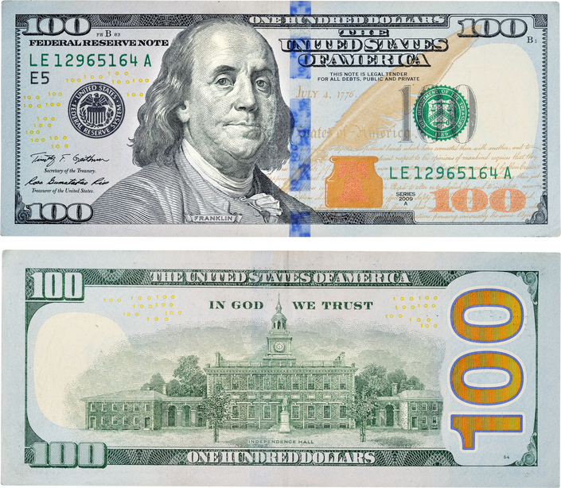
"In America, you don’t choose a doctor, you choose what you can afford."

